Slide 1
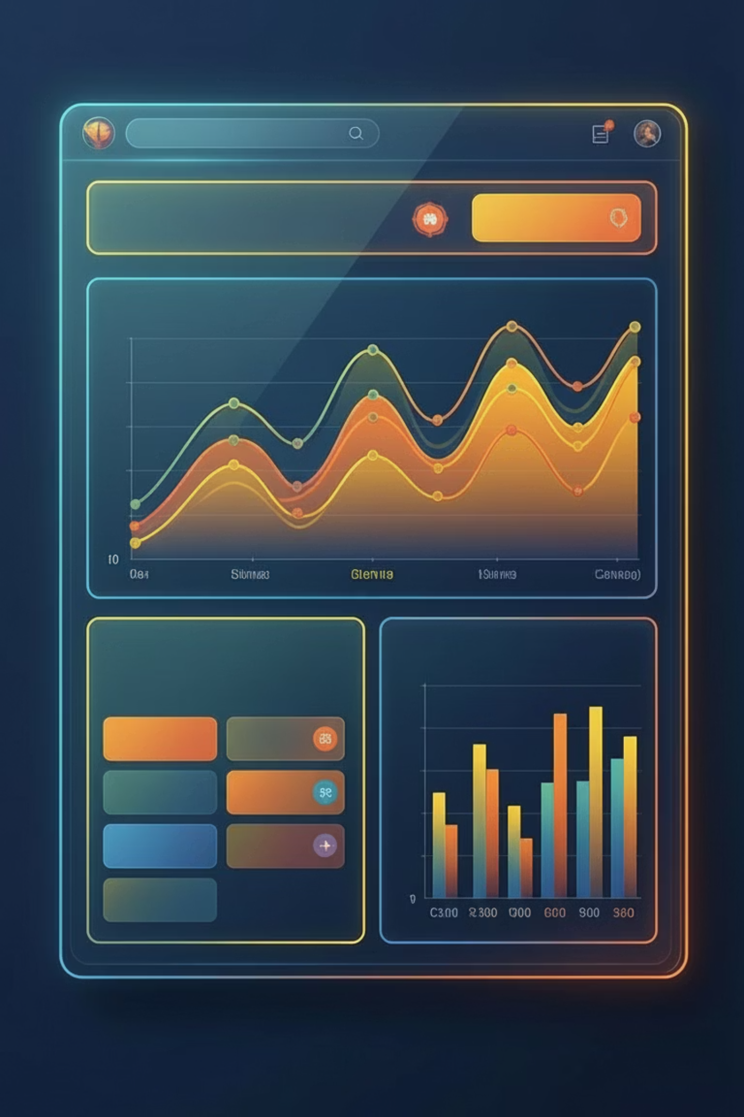
Customer Shopping Behavior Analysis
Uncovering insights from 3,900 purchases to guide strategic business decisions

Slide 2

DATASET OVERVIEW
The Foundation
3,900
18
$59.7
Total Purchases
Data Columns
Avg Purchase
Transactions analyzed
Features tracked
Per transaction
3.75
Avg Rating
Customer satisfaction

Slide 3

PYTHON ANALYSIS
Data Preparation Process
01
02
03
Data Loading
Exploration
Missing Data
Imported dataset using Pandas
Used df.info() and .describe() for structure analysis
Imputed 37 missing Review Ratings using median by category
04
05
Feature Engineering
Database Integration
Created age_group and frequency_purchased_days columns
Connected to MySQL for SQL analysis

Slide 4
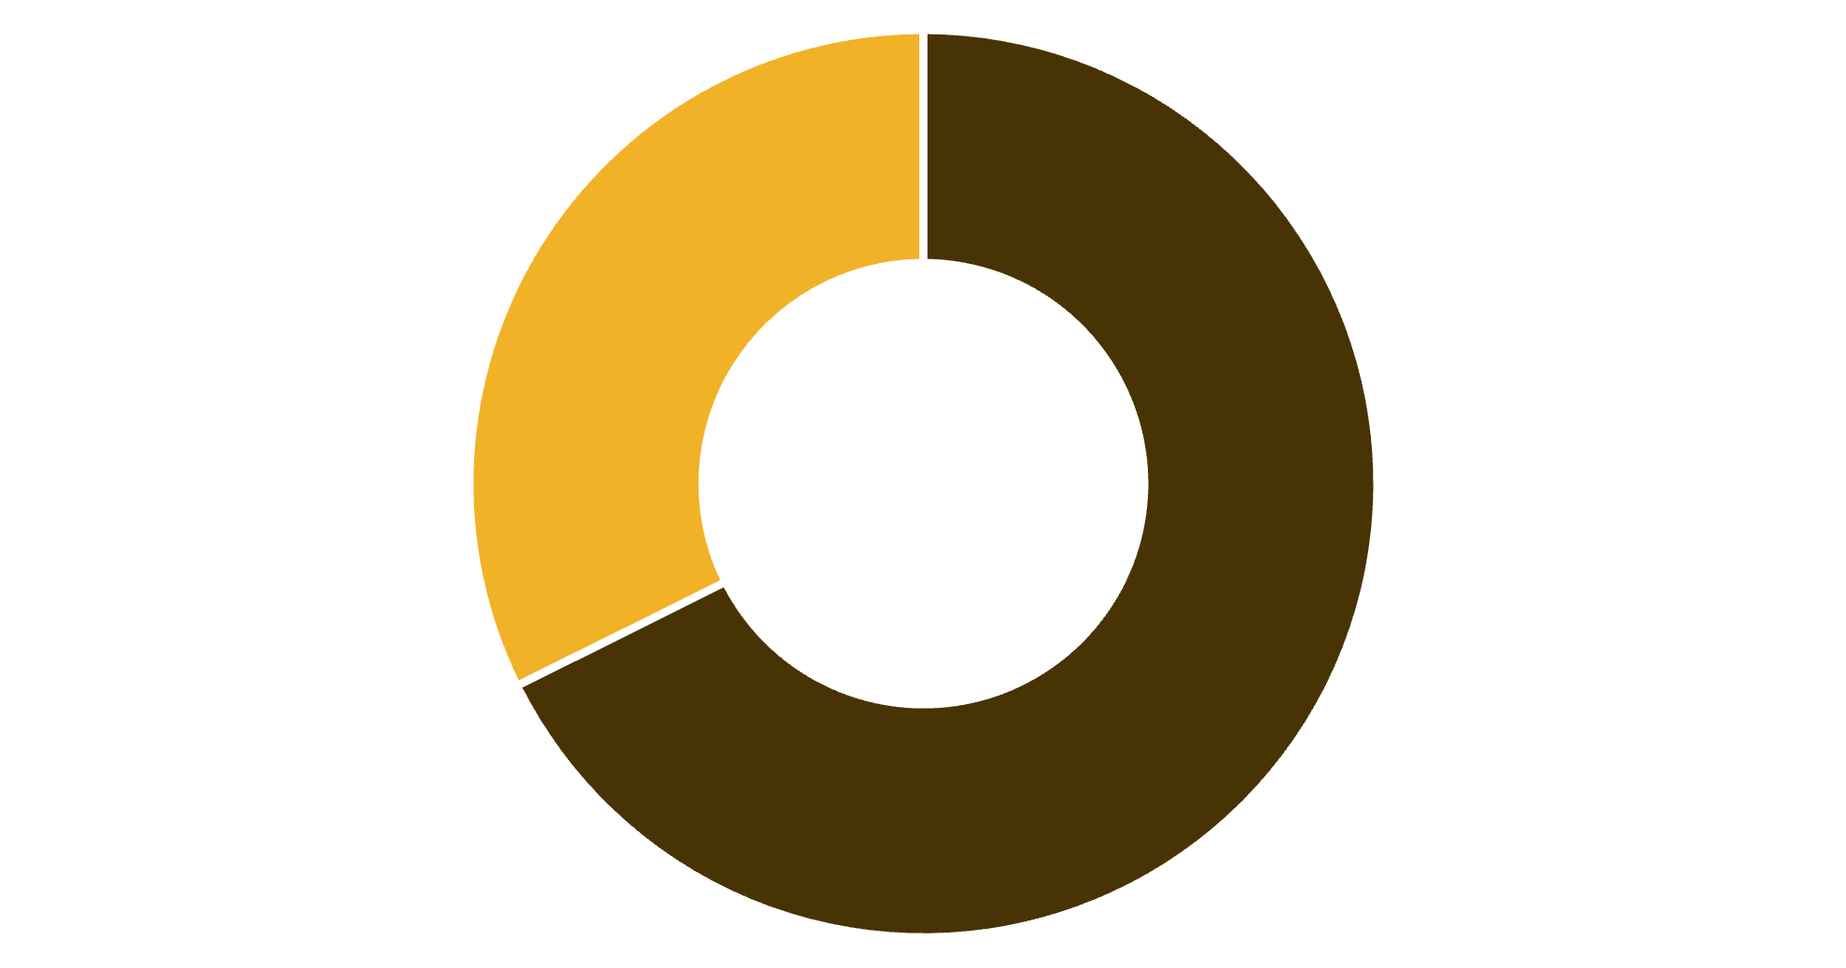
KEY FINDING
Revenue by Gender
$157,890
Male customers generated 68% of total revenue
$75,191
Female customers contributed 32%
Male
Female

Slide 5





Top Performing Products
Gloves
Sandals
Boots
3.86 rating
3.84 rating
3.82 rating
Hat
Handbag
3.80 rating
3.78 rating

Slide 6
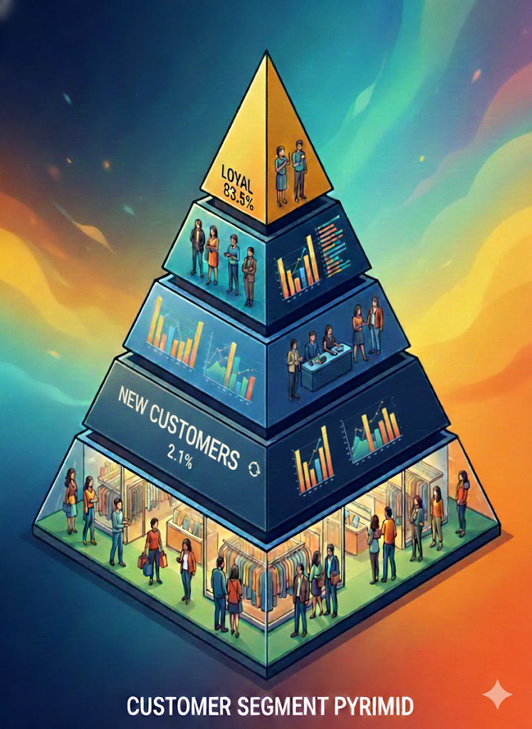



CUSTOMER SEGMENTS
Loyalty Distribution
Majority of customers are loyal repeat buyers, presenting strong retention opportunity
83.5%
14.4%
Loyal
Returning
3,257 customers
560 customers
2.1%
New
83 customers

Slide 7
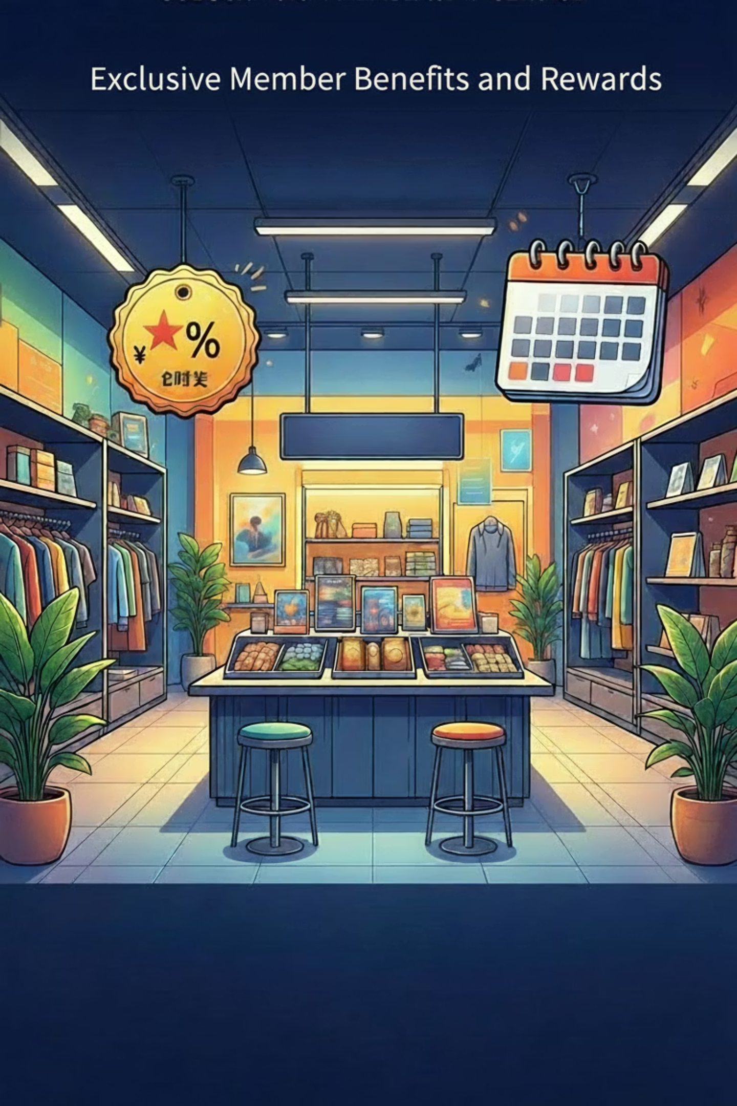



Subscription Analysis
Subscribers
1,053 customers (27%)
$59.49 avg spend
$62,645 total revenue
Non-Subscribers
2,847 customers (73%)
$59.87 avg spend
$170,436 total revenue
Repeat buyers (>5 purchases): 958 subscribers vs 2,518 non-subscribers

Slide 8

REVENUE INSIGHTS
Age Group Performance
Young adults lead revenue generation, followed closely by middle-aged customers

Slide 9
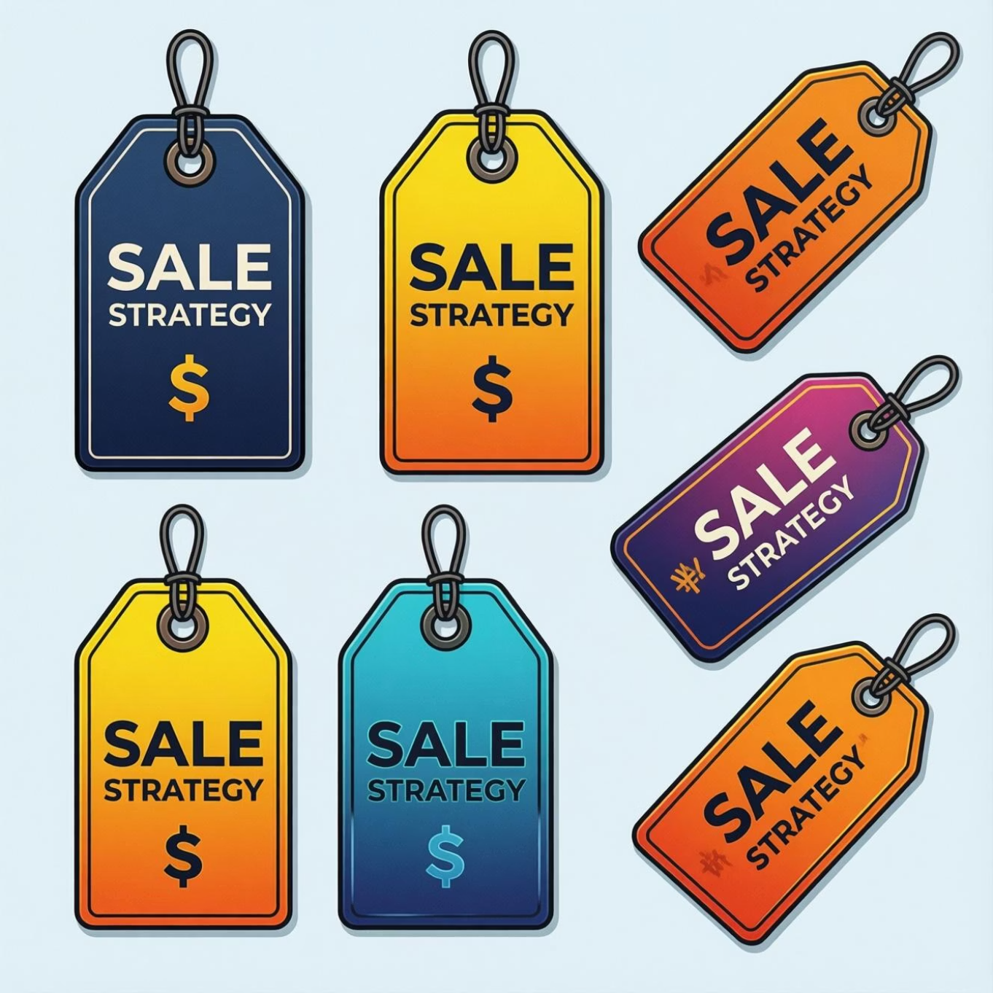
Discount Strategy Insights
Products Most Dependent on Discounts
50%
Hat
49.7%
Sneakers
49.1%
Coat
48.2%
Sweater
47.4%
High-spending discount users still purchase above average amounts
Pants

Slide 10




RECOMMENDATIONS
Strategic Action Plan
Optimize Subscriptions
Loyalty Integration
Introduce exclusive benefits and savings for subscribers
Reward repeat buyers to move them into loyal segment
Review Discounts
Audit promotional policy to protect margins
Product Placement
Highlight top-rated and best-selling items
Targeted Marketing
Focus on high-revenue age groups and express shipping users

